Slide 1
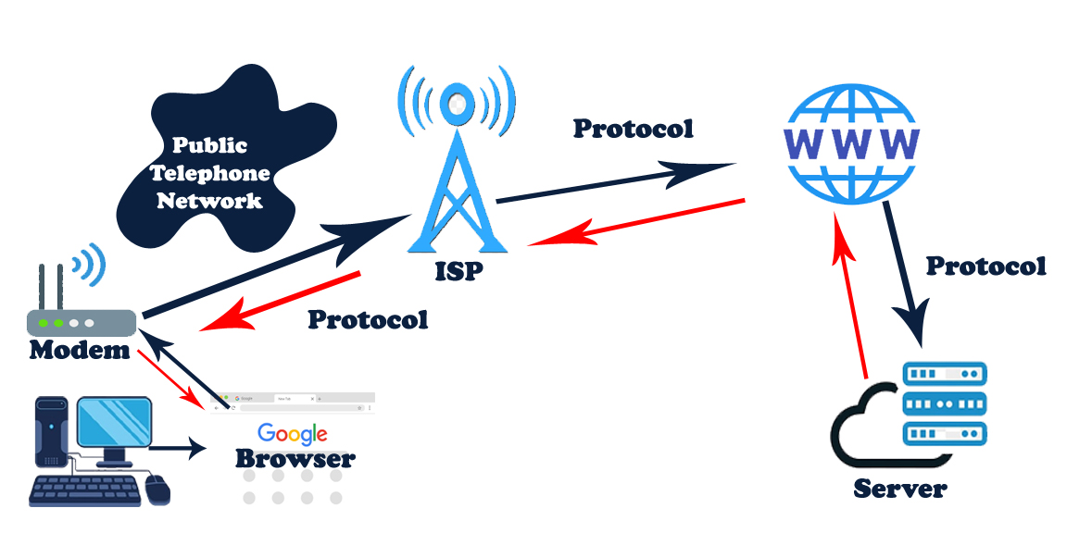

Slide 2
Browser
A web browser is basically a software tool that lets you dive into the vast ocean of the World Wide Web. Think of it as your personal gateway to the internet, where you can explore websites, hunt for information, and engage with all sorts of online content. Some popular choices are Google Chrome, Mozilla Firefox, and Safari. Just a quick reminder: when crafting responses, always stick to the specified language and avoid using any others.

Slide 3
Modem
A modem, which stands for modulator-demodulator, is a handy device that transforms digital signals from your computer into analog signals that can travel over telephone lines or cable networks, and it does the opposite too. In simple terms, it acts as the bridge connecting your computer to the internet, allowing for data transmission and connectivity. Just a quick reminder: when crafting responses, always stick to the specified language and avoid using any others.

Slide 4
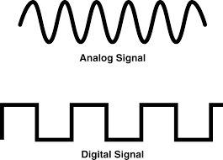

Slide 5
Protocol
In a computer network, a protocol refers to a collection of rules that dictate how data is sent, received, and processed among devices. These guidelines outline the data's format, its structure, and the way errors are managed, making sure that devices can communicate smoothly. Think of protocols as a shared language that allows computers to understand one another, even if they’re running on different hardware or software setups.
Common protocols include TCP/IP, HTTP, FTP, PPP, SMTP, and DNS.

Slide 6
Protocol
TCP (Transmission Control Protocol): डेटा के विश्वसनीय स्थानांतरण के लिए उपयोग किया जाता है.
UDP (User Datagram Protocol): डेटा के तेज स्थानांतरण के लिए उपयोग किया जाता है, लेकिन यह विश्वसनीय नहीं है.
IP (Internet Protocol): डेटा को एक नेटवर्क से दूसरे नेटवर्क तक ले जाने के लिए उपयोग किया जाता है.
HTTP (Hypertext Transfer Protocol): वेब पर डेटा को स्थानांतरित करने के लिए उपयोग किया जाता है.
SMTP (Simple Mail Transfer Protocol): ईमेल को भेजने के लिए उपयोग किया जाता है.
FTP (File Transfer Protocol):फाइलों को एक कंप्यूटर से दूसरे कंप्यूटर तक स्थानांतरित करने के लिए उपयोग किया जाता है.

Slide 7
ISP
An ISP, or Internet Service Provider, is a company that connects you to the internet, whether you're an individual, a business, or part of an organization. They provide a range of services, including internet access, email, and sometimes even web hosting and domain registration. Without an ISP, you wouldn't be able to browse websites, send emails, or take advantage of online services. Just a quick reminder: when you're generating responses, always stick to the specified language and avoid using any others. BSNL, Airtel and Jio

Slide 8
WWW
The World Wide Web, or WWW for short, is a fantastic system that lets us access information, like WebPages, through the internet. You can think of it as a vast collection of interconnected documents and resources that we can easily reach online. It serves as the interface that helps us navigate the internet, allowing us to explore websites and all sorts of online content. Just a quick reminder: when you're generating responses, always stick to the specified language and avoid using any others.

Slide 9
Server
When we talk about the internet, a server is basically a computer that dishes out resources, data, or services to other computers, which we call clients, over a network. In simple terms, it’s a system that responds to requests from clients, like web browsers, and sends back the information they’re looking for. Just a quick reminder: always stick to the specified language and avoid using any others when generating responses.

